Slide 1
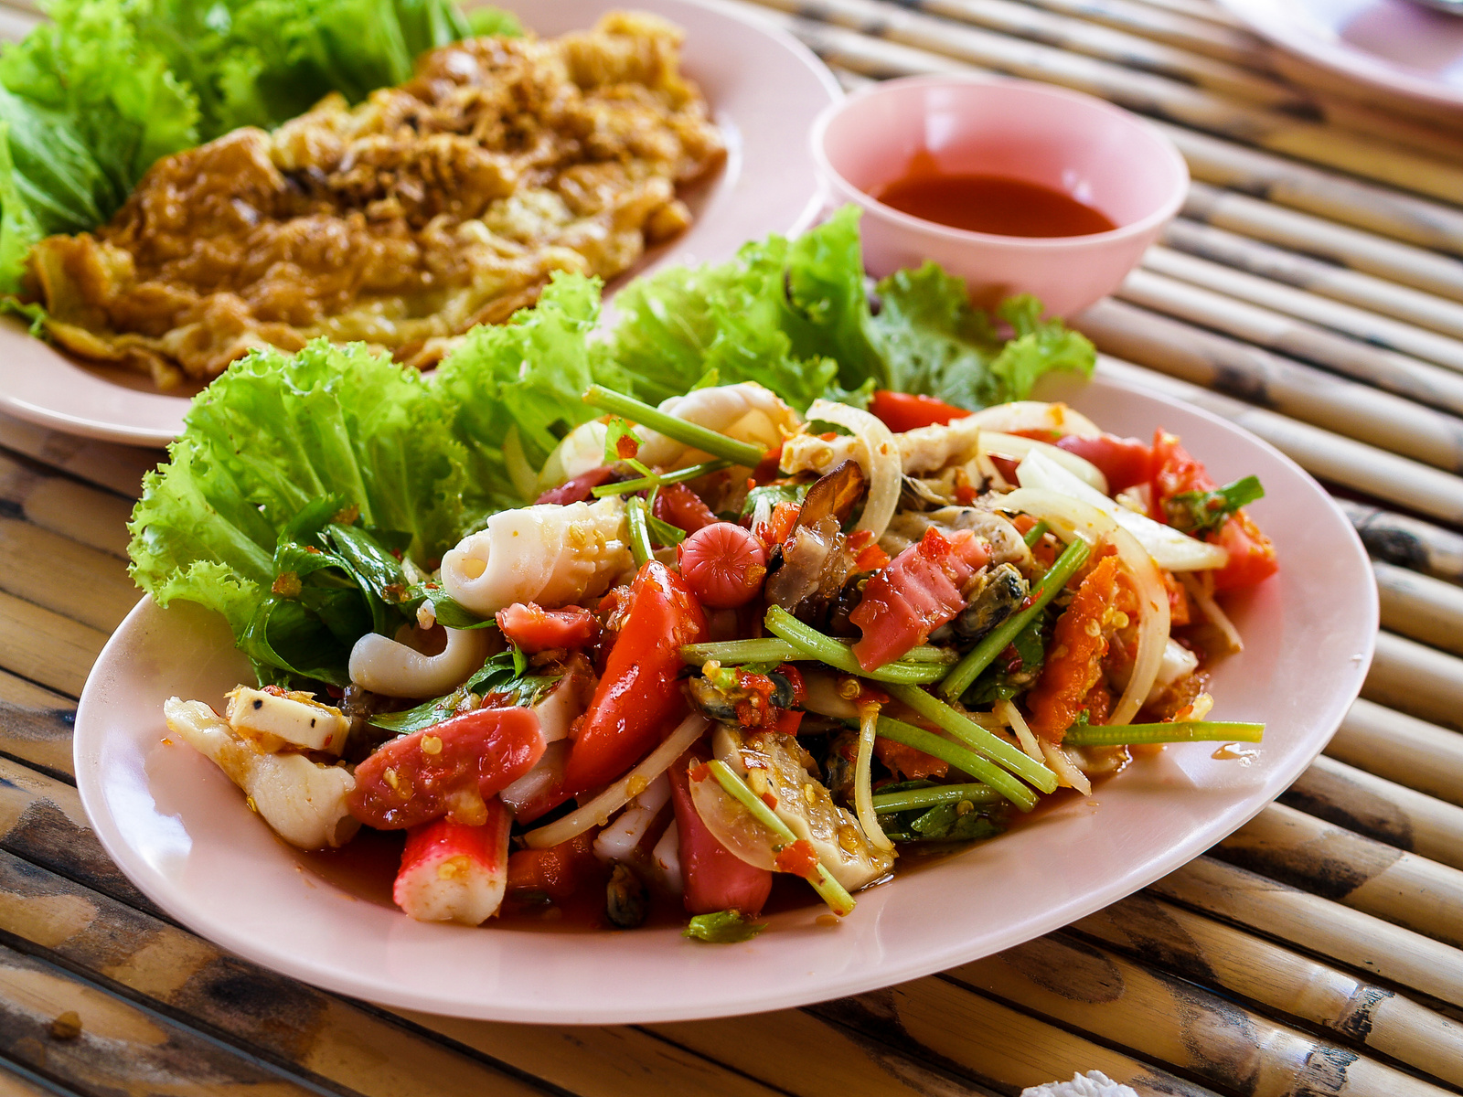

Yelp
Review
Sentimental Analysis

Slide 2
Table of Content
1
Introduction
2
Analysis
3
Conclusion
Market
Project Task
Data Introduction
Pre-processing
Sentimental Analysis
Topic Modeling
Conclusion
Q&A

Slide 3

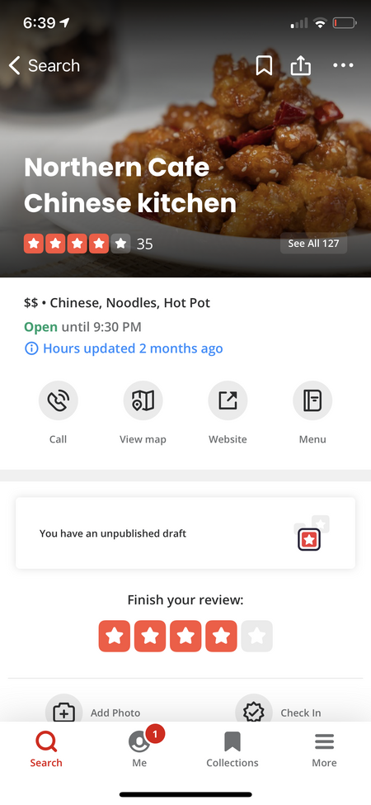
2021 Q2 revenue is more than
$257M
Yelp rating can increase
a business owner’s sales by
5-9%

Slide 4



PROJECT TASK
Topic modeling (Positive)
Topic modeling (Negative)
Topic modeling (Neutral)
Topic modeling to extract the reasons why people give positive comments to business.
Topic modeling to extract the reasons why people give negative comments to business.
Sentiment Analysis and topic modeling extract actual negative and positive comments from neutral comments

Slide 5
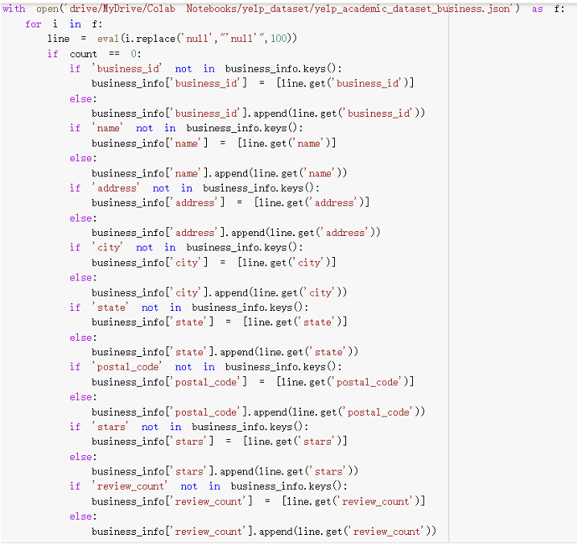
DATA INTRODUCTION
business.json
business_id
stars
city
state
review_count.
Review.json
review_id
business_id
stars
useful
etc
Dataset size: 8.6 millons

Slide 6
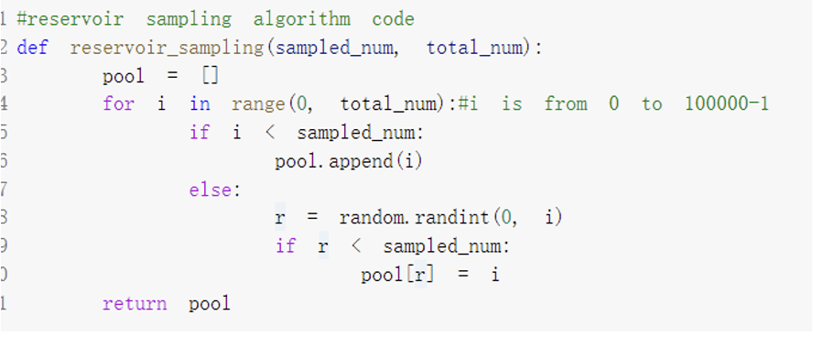
RESERVOIR SAMPLING ALGORITHM
1
Reservoir Sampling Method
2
Randomly pick 100,000 value
from 0 to 8,635,403
3
Use as Index

Slide 7
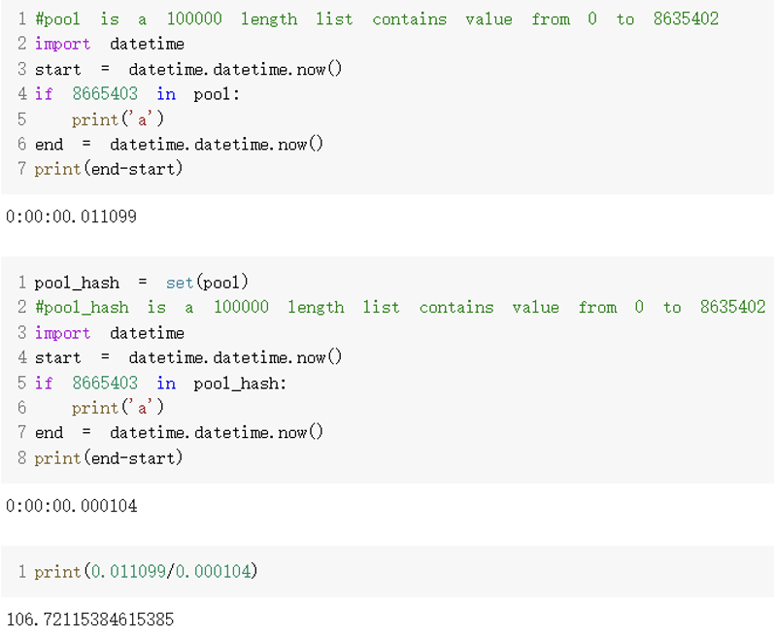
RESERVOIR SAMPLING ALGORITHM
20 Hours
Hashing
20 Minutes

Slide 8
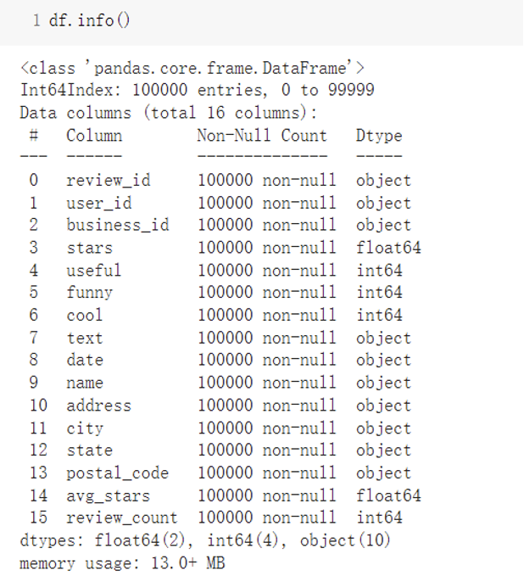
DATA
VISUALIZAION
100,000 Rows
16 Columns
0 N//A Values

Slide 9
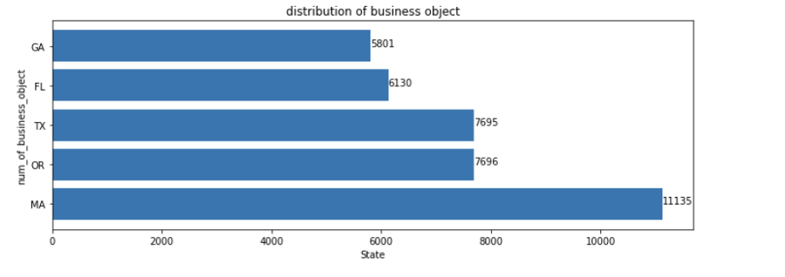
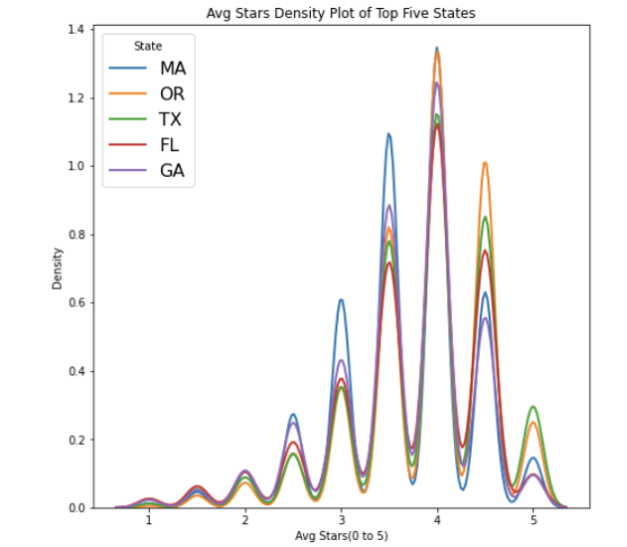
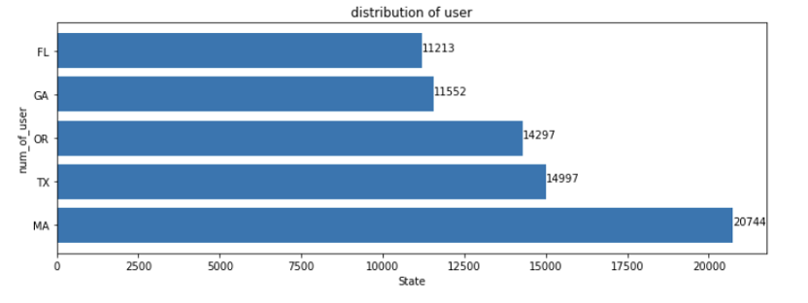
GA(Georgia),FL(Florida),TX(Texas),OR(Oregon),MA(Massachusetts) are the top five states

Slide 10
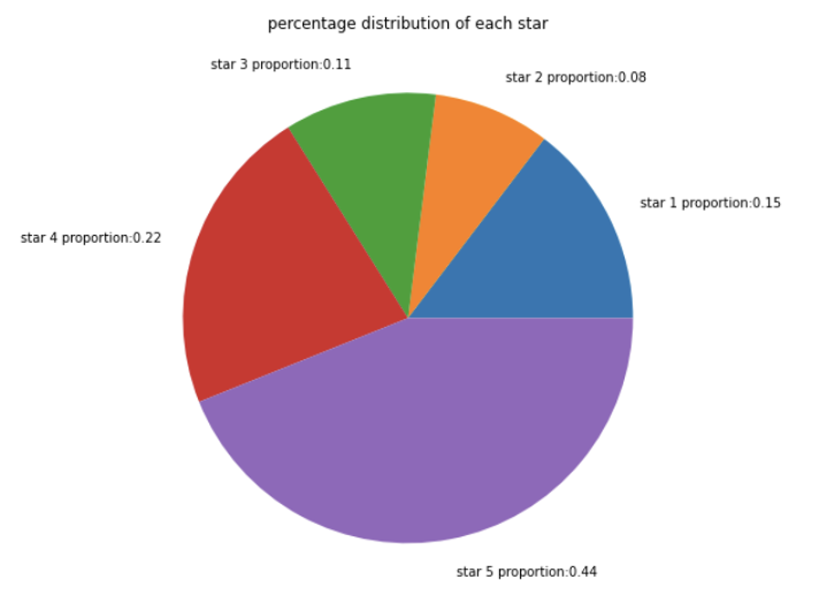
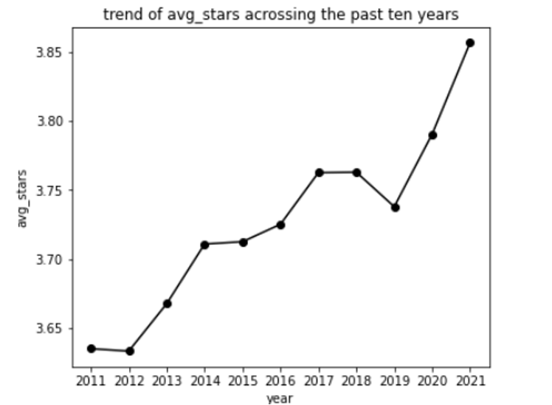
positive(4 or 5 stars) comments takes 66%, negative(1 or 2 stars) take 23%, neutral(3 stars) takes 11%

Slide 11
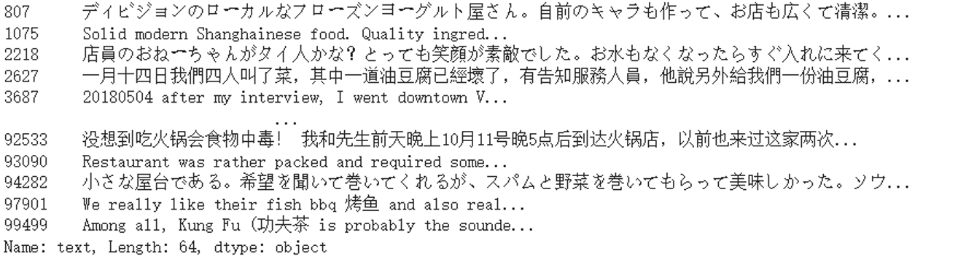
DATA CLEANING
Remove all of the reviews in foreign languages

Slide 12
DATA PRE-PROCESSING
Make all text "lower case"
Remove "stopwords" from text
"Amplify" the voice of each user’s comment

Slide 13


SENTIMENTAL ANALYSIS
NEGATIVE
NEUTRAL
POSITIVE
1~2 stars
4~5 stars

Slide 14
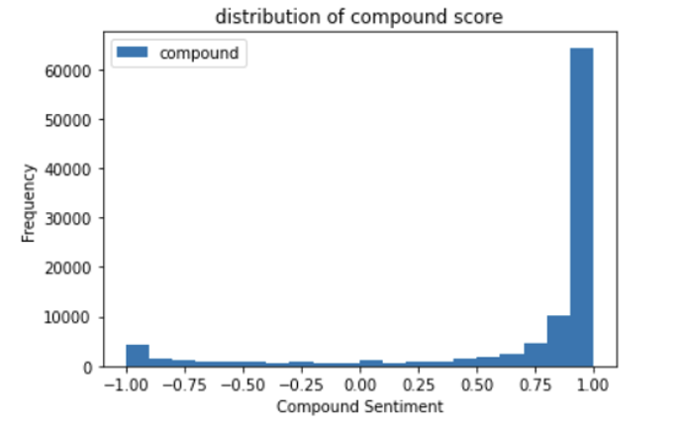
SENTIMENTAL ANALYSIS
Average stars of the dataset is around 3.5
Compound score is skewed to positive 1

Slide 15
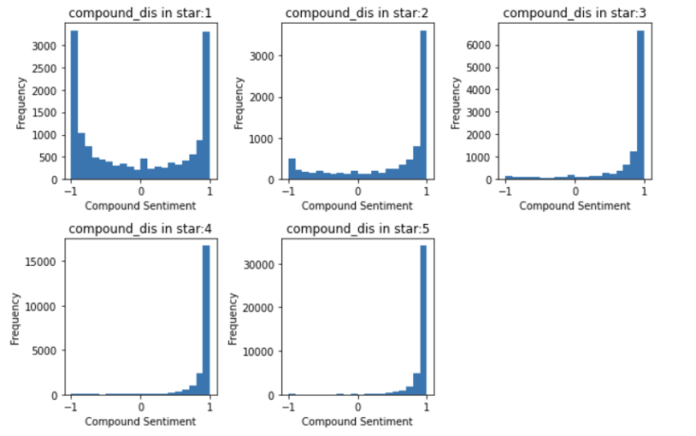
SENTIMENTAL ANALYSIS
Distribution of compound score change when star increases
Compound score moved to positive 1

Slide 16
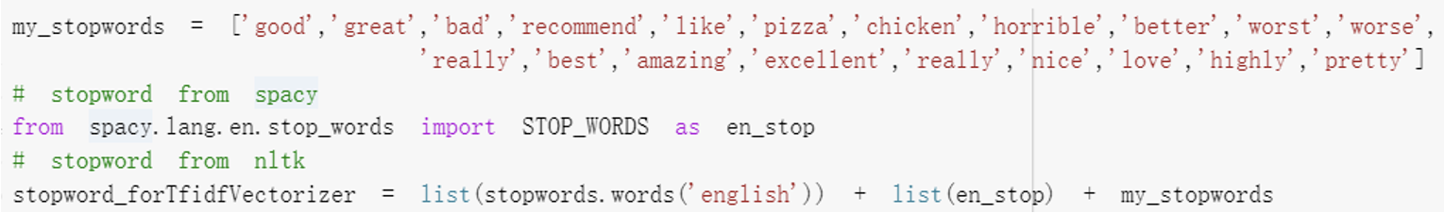
TOPIC MODELING
Model Building
Create our own stopword package
Stopword(English) From spacy.lang.en.stop_words: 326
Stopword(English) From NLTK: 179
Manually created stopwords: 20
Our own stopword: 525

Slide 17
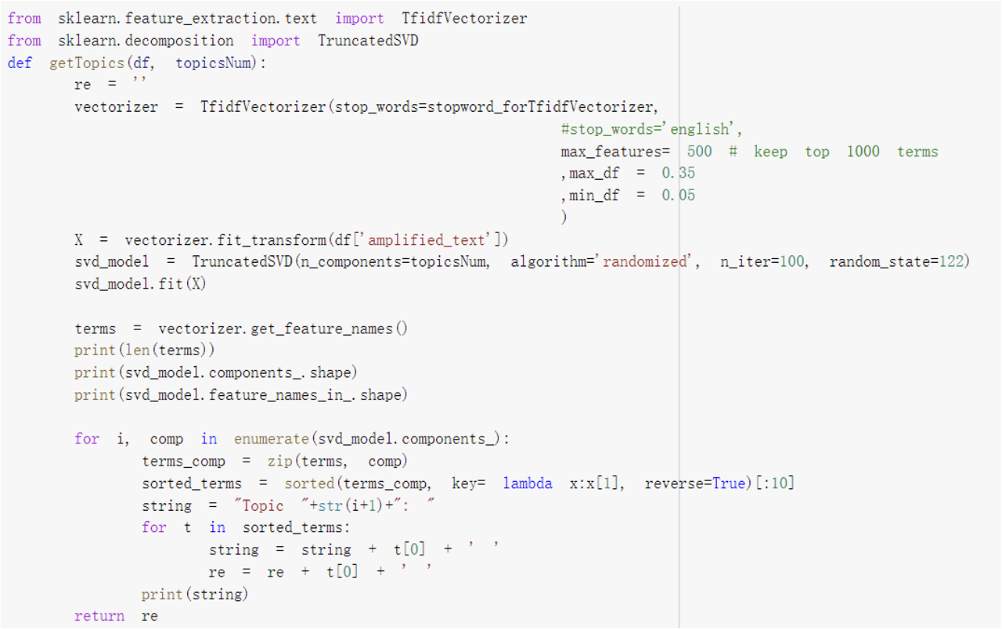
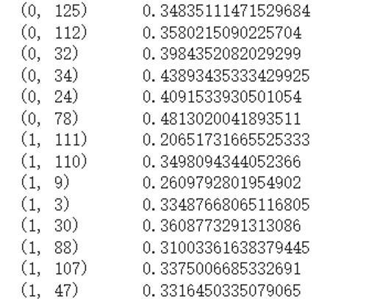
TOPIC MODELING
(A, B)
C
TfidfVectorizer
A : Index for Comment
B : Index for Keyword
C : Level of Importance

Slide 18

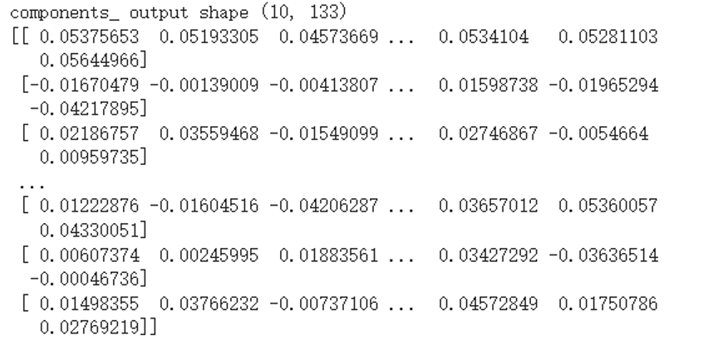
TOPIC MODELING
TruncatedSVD
Row : Topic
Value : Importance of the keyword

Slide 19
TOPIC MODELING

Slide 20
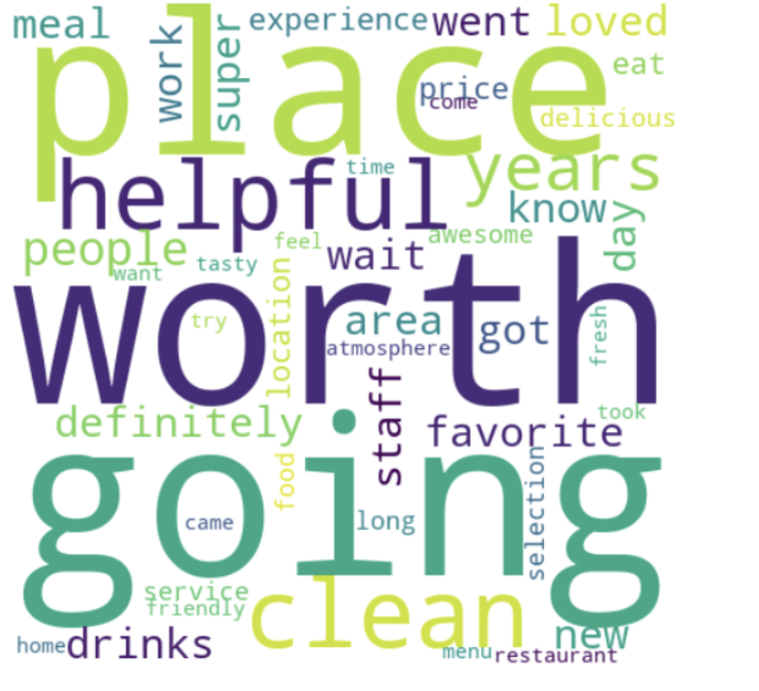
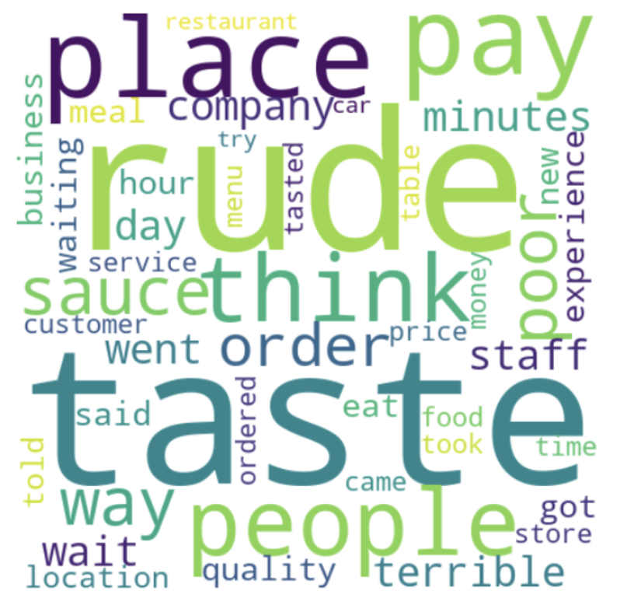
TOPIC MODELING
POSITIVE
NEGATIVE

Slide 21
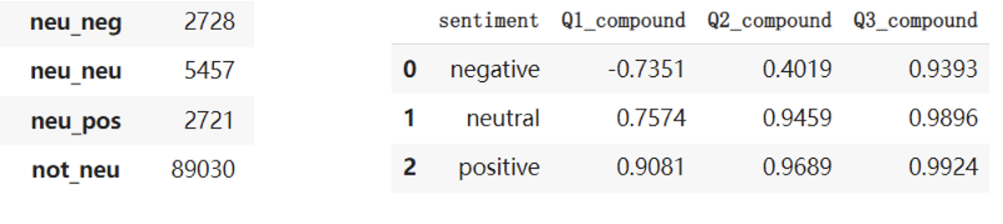
NEUTRAL COMMENT
neu_neg
3 stars comment with compound score <= Q1
neu_pos
3 stars comment with compound score > Q3
neu_nue
3 stars comment with compound between Q1 and Q3

Slide 22
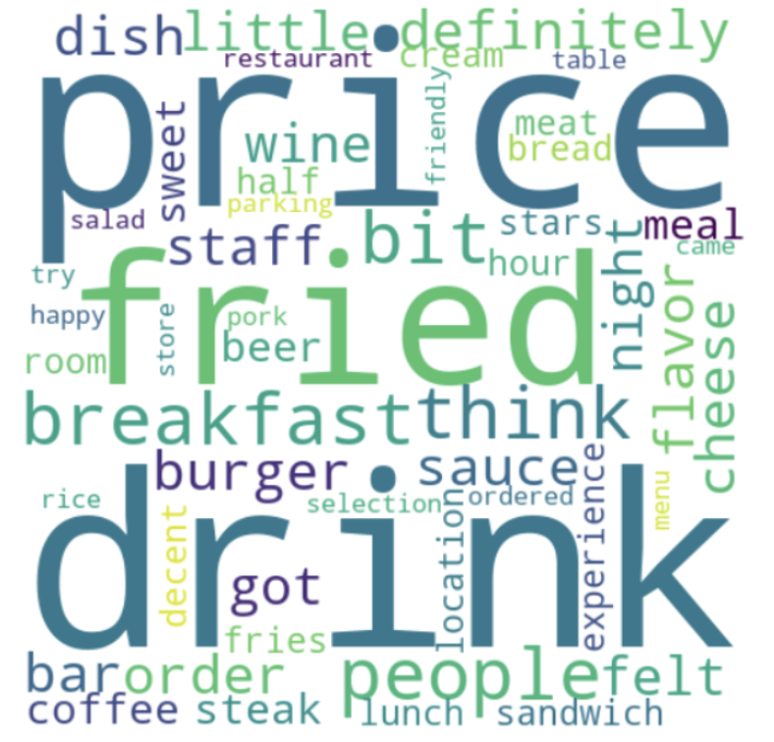
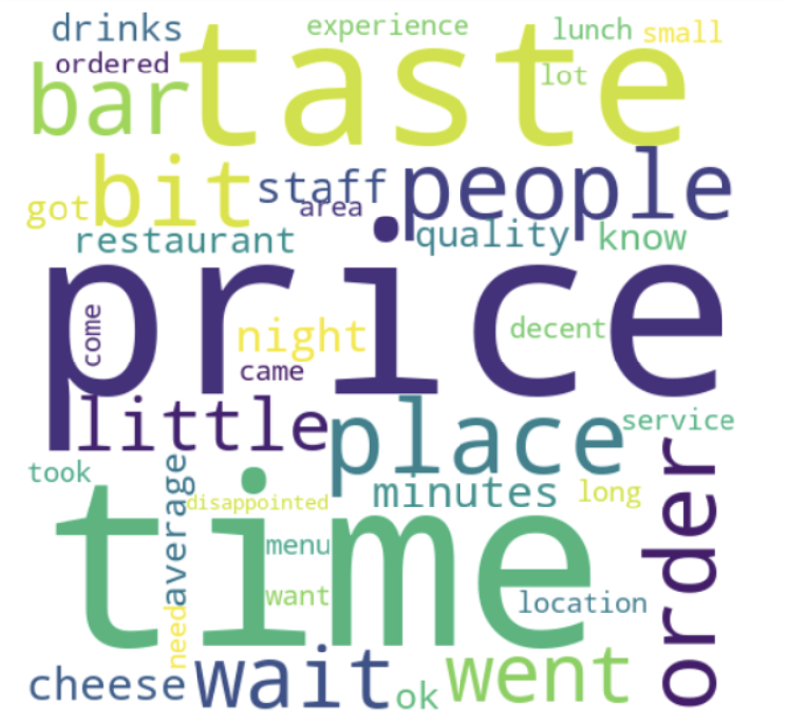
TOPIC MODELING
POSITIVE
NEGATIVE

Slide 23
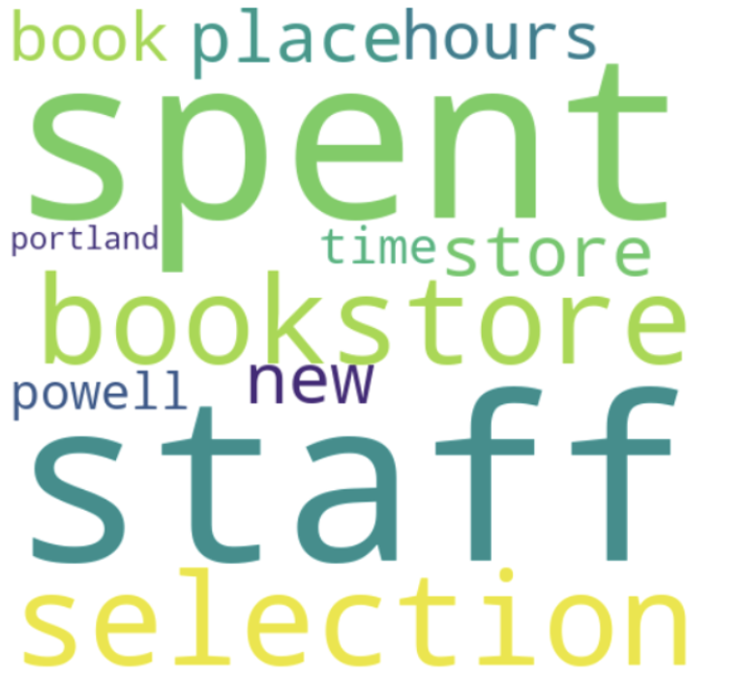
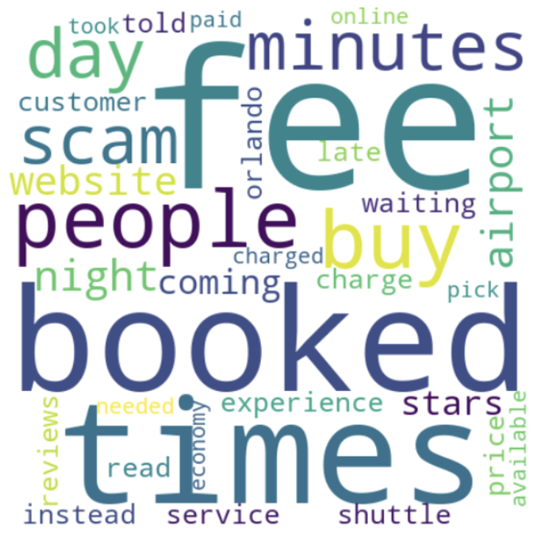
TOPIC MODELING
BOOK STORE
CAR RENTAL

Slide 24
CONCLUSION
Successfully extract why users give positive or negative comments
Extract the negative and positive comment from neutral comment
Understand why the neutral comment is skewed toward
positive or negative
Offer accurate advice to the other business

